Slide 1
Tower Lakes Improvement Association
January 17, 2021
Annual Meeting

Slide 2
Quorum
10% of membership to qualify present or via proxy vote

Slide 3
Roll Call of Officers

Slide 4
Approval of
2020 Annual
Meeting Minutes

Slide 5
Approval of
December 2020
Meeting Minutes

Slide 6
President’s Comments

Slide 7
TLIA Board & Committees
Financial Secretary
Vice President
President
Treasurer
Secretary
Melissa Covek (2022)
Mary Magro (2022)
Steve Burgoon (2021)
Tom Kuna (2021)
Kristi Nash (2021)
Finance
Ex Officio (all committees)
Finance (Chair)
Communications
Transition/ LRP
Member at Large
Member at Large
Member at Large
Member at Large
Mike Megleo (2022)
Mark Handley (2022)
Mitch Coulter (2021)
Mike Mitchell (2021)
Grounds Committee (Chair)
Member Services (Chair)
Lake Committee
Grounds, Finance
(Co-Chair)
Steve Kruse (Co-Chair)
STANDING COMMITTEES
Grounds Beautification & Tennis
Communications
Social/Events
Youth
Beach
Chair
Chair
Chair
Chair
Chair
Pat Covek
Mary Kay Bolger
Jeff Kernohan
Gina Thompson
Mary Magro
Long Range Planning
Committee Vacancies
Nominations
Chair Mike Megleo
Boating, Legal
Chair
Mary Beth Adams

Slide 8
Community Demographics
Demographics of Tower Lakes New Residents –June 2014 through December 10, 2020
Number of Families: | 2014 | 2015 | 2016 | 2017 | 2018 | 2019 | 2020 | Total
New VOTL resident HH | 18 | 12 | 22 | 22 | 18 | 18 | 30 | 140
New Rentals = VOTL | 1 | 0 | 3 | 1 | 1 | 2 | 8 | 16 | 11%
New HH = TLIA | 16 | 11 | 19 | 20 | 18 | 17 | 27 | 128 | 91%
New HH = CCE | 2 | 1 | 3 | 0 | 0 | 1 | 1 | 8 | 6%
New HH = Fenview | 0 | 0 | 0 | 2 | 0 | 0 | 2 | 4 | 3%
Two adults | 14 | 8 | 17 | 18 | 14 | 14 | 24 | 109 | 90%
Single adult | 4 | 4 | 5 | 4 | 4 | 4 | 6 | 31 | 26%
Children ages 1-18 | 11 | 9 | 15 | 13 | 6 | 8 | 17 | 79 | 65%
Children at home | 7 | 3 | 7 | 9 | 12 | 10 | 13 | 61 | 50%
Adults age under 55 | 14 | 11 | 19 | 15 | 10 | 7 | 24 | 100 | 83%
With adults age 55+ | 4 | 1 | 3 | 7 | 8 | 11 | 6 | 40 | 33%
% 55+ years | 22.2% | 8.3% | 13.6% | 31.8% | 44.4% | 61.1% | 20.0%

Slide 9
2019 to 2012 Accomplishments
Build on past successes from past boards/leadership
Archives – move to cloud storage – Need some help!!!
Position for the future
2024 = 100 Years for TL
Continued Collaboration with VOTL
Hydrology Study… and anything to do with Grounds and Lakes
Collaborative Communication
Tree Programs
100 Year Celebration
Storage…
Continue to Build the Team
Understand our Demographics
Cultivate our diverse talent
Continuous transition – Committees and 2-year terms

Slide 10
Nominations
Committee

Slide 11
The 2021 TLIA Board:
Candidates for Election

Slide 12
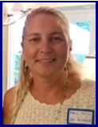
For President
Mary Magro
I moved to Tower Lakes 32 years ago with my parents and since then have married the boy across the street, have three beautiful children and live in North Lake.
I have been involved with Tower Lakes for the past 16 years (Social committee, Tennis Courts, TLIA Treasurer, Grounds Beautification, Beach Committee as well as volunteering at many activities in TL). I currently am serving on the TLIA board as Vice President and am running for President because of my knowledge of the history of TL . I would like to continue to give back to the community that helped me raise my family to become happy, well-rounded young adults.
Tower Lakes is a beautiful place to live and I would like to help keep it that way - finding new ways to enhance our neighborhood while keeping it safe.

Slide 13
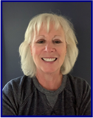
For Treasurer
Mary Kay Bolger
My husband, Tom, and I moved to Tower Lakes with our three children over 19 years ago. Tom had first moved here when his family relocated here from Michigan in 1968.
Since 2001, I have been on the TLIA Events Committee for two years, serving as its treasurer, the Youth Tennis Chairperson for five years, also as it's treasurer, the Beach Committee for three years, the Tennis Committee for a year and most recently have been the Communications Committee Chairperson for the past two years.
In the past I held numerous volunteer positions in my children's schools, sport teams and in my community and I am currently volunteering as a Bereavement Minister at St. Anne Catholic Church in Barrington.
I graduated from Western Illinois University with a degree in Communications and have worked professionally in the Customer Service world for over 10 years, gaining experience in Excel, Word and PowerPoint.
I truly feel that TL is the best place to raise a family and I want to continue to give back to the community that has provided so much to my family over the years.

Slide 14
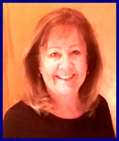
For Recording Secretary
Kristi Nash
My name is Kristi Nash and my husband, Bob, and I have lived in Tower Lakes for 16 years on North Lake. We have a family of four grown children with 7 beautiful grandchildren.
I served on the Social Committee for two terms and have been Recording Secretary for the last two years. I have an MBA from Lake Forest Graduate School of Management with an undergraduate degree in Business from Indiana University. I am currently working at Takeda Pharmaceuticals as a Program Manager in IT.
I enjoy hiking, kayaking, and power walking around the whole of Tower Lakes and am looking forward to the completion of the WALK TL project.

Slide 15
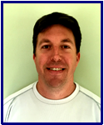
For Member-at-Large
Mike Meyer
My wife, Sarah, and I along with our two daughters, Quinn and Amelia, moved to Tower Lakes in May of 2019.
We were searching for an area with great families and a strong community feel. We were familiar with Tower Lakes and knew it would be the perfect place for our family.
After moving in, we dove right into attending all the activities and community events Tower Lakes offers. Tower Lakes has been great to my family in the short amount of time we have lived here. I feel it is important to give back to a community that provides so much for their residents

Slide 16
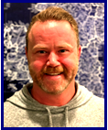
For Member-at-Large
Colin Regan
My wife, Amy, and I moved to Tower Lakes in January of 2016 with our son, Declan, after discovering this wonderful, resort-like community one day on a bike ride. I promptly came home and declared that our next home would be in Tower Lakes. Amy humored me, since she grew up in the Barrington area and already knew about all TL had to offer our family. In September 2017 we added another member to the family, Brigid. Brigid and Declan love the TL lifestyle and they spend most of the warm months swimming in the lake, kayaking, fishing and exploring.
I was quickly recruited by Nick Adams to join the Lake Committee and have served as a member ever since. As a member of the Lake Committee, I have strived to ensure that our greatest asset, the lake, can be enjoyed by all whether that’s swimming, boating, fishing, or a combination. I have assisted in the negotiation of our most recent service contract with TL’s current lake maintenance provider and look forward to continuing to help preserve and enhance our community’s greatest asset.

Slide 17
Finance
Committee

Slide 18
Treasurer’s
Report
Tom Kuna

Slide 19
Profit and Loss 2020 Budget vs Actual

Slide 20
Profit and Loss 2020 Budget vs Actual

Slide 21
TLIA Cash Balances

Slide 22
5 Year Summary of Capital Expenditures

Slide 23
Contributions to
Capital Reserve Account

Slide 24
TLIA 2021 Budget - Expenses

Slide 25
Dues
Melissa Covek

Slide 26
TLIA Income 2020
Regular Dues | $ 135,700
Senior Dues | $ 62,400
Vacant Lot Dues | $ 1,200
TOTAL | $ 199,300
Revenue from Committees | $ 10,951
Late Fees | $ 1,700
RFPP | $ 6,900
Misc. Services (LPA’s, Swim lessons, Turkey Trot, etc.) | $ 6,333
Lake SA (Year 4) | $ 71,000
Total Other Incoming Monies | $ 96,884
TOTAL OF ALL DEPOSITS | $ 296,184

Slide 27

Dues Collection- Results 2020 & moving forward into 2021
Outstanding Dues, as of January 1, 2020 $2,522
4 Homeowners were in arrears, 1 of them owed $1,716 (70%)
of the $2,522
$525 was written off due to a foreclosure
$3,366 in Dues was collected via the lawsuit for possession of property we filed and won. In addition, 100% of TLIA legal bills were reimbursed by the property owner
Outstanding Dues, as of January 1, 2021 $3,500
4 new Homeowners are in arrears
$4,139 in Dues was collected from one owner we were pursuing legal action against. 100% of TLIA legal bills were reimbursed by the property owner

Slide 28
Other Notable Efforts in 2020
335 Dues invoices were sent electronically at the beginning of January 2020, an additional 35 invoices were mailed to those for whom we had no email address. On the e-invoice, there is option to pay via ACH (bank to bank), so those that do not want to pay by check have a 2nd e-payment method in addition to their own banks.
168 Invoices were paid by ACH in 2020
NOTE: OUR BANK ACCOUNT is a COMMERCIAL ACCOUNT, they will NOT accept payments to it from Venmo, Zelle or similar money transfer applications.

Slide 29
Beach
Committee

Slide 30


Hired 12 lifeguards initially – more over the summer
100% mandatory member tag check
(no exceptions)
Implemented and enforced COVID policies
Two new rafts
for the swimming area
All picnic tables and benches painted
Tower Lakes Beach sign totally refurbished
Security system and motion-activated lights installed
Guard Shack got a major end of season cleanup
2020 Recap

Slide 31
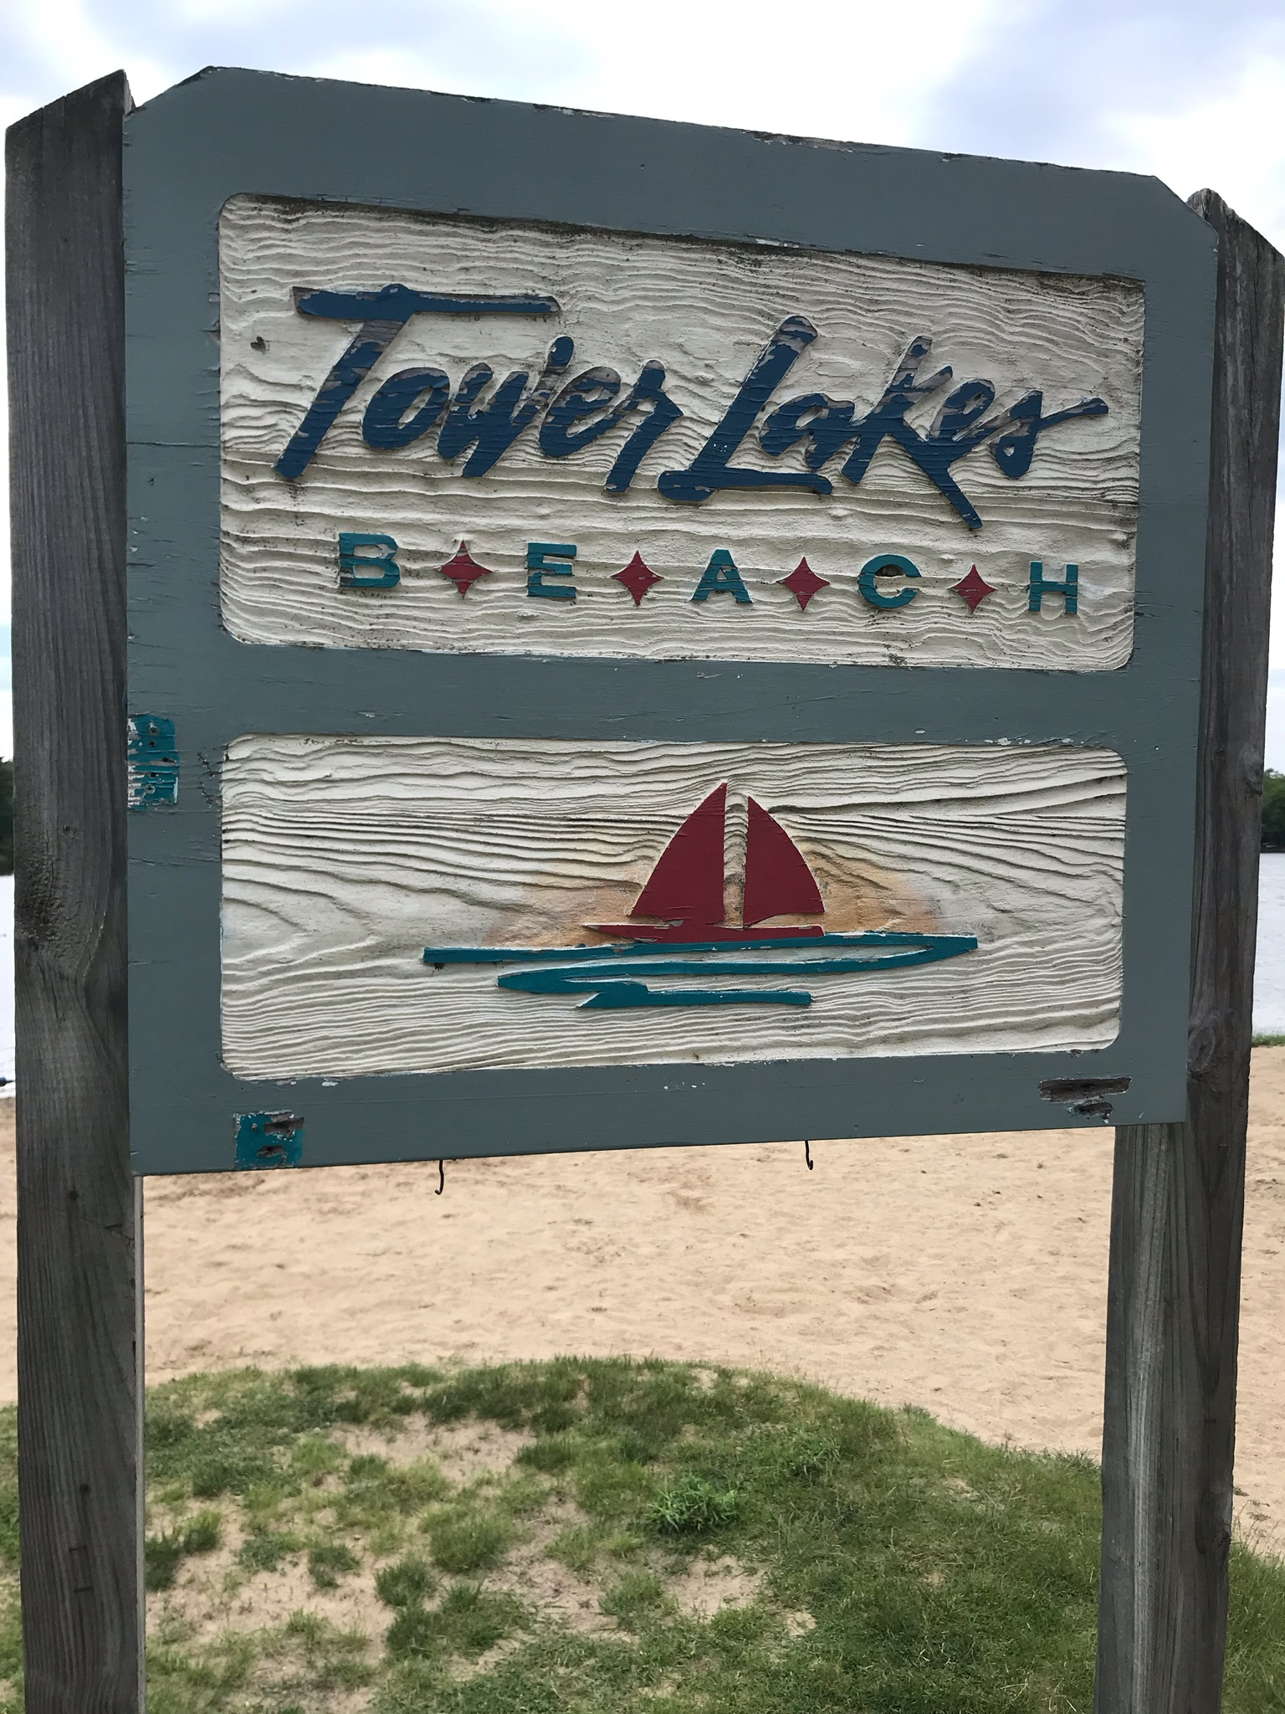
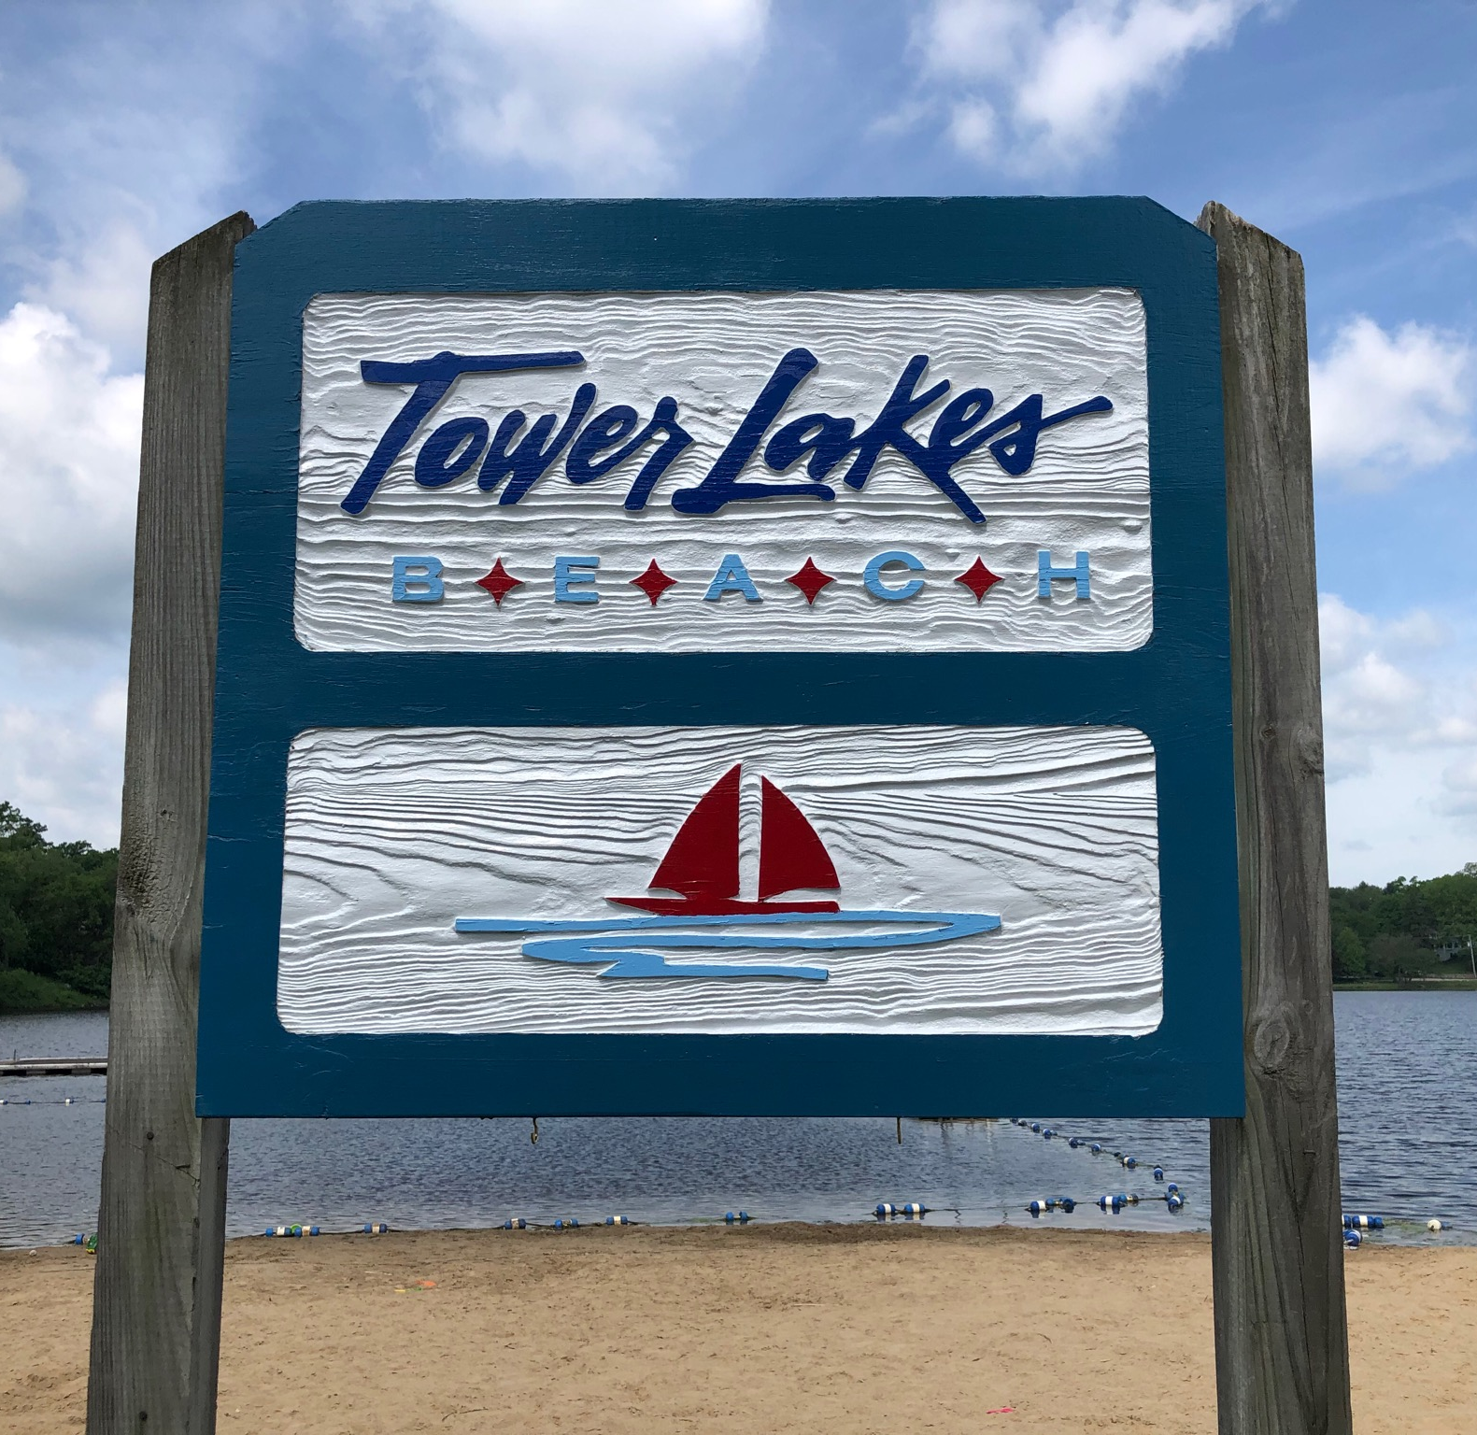
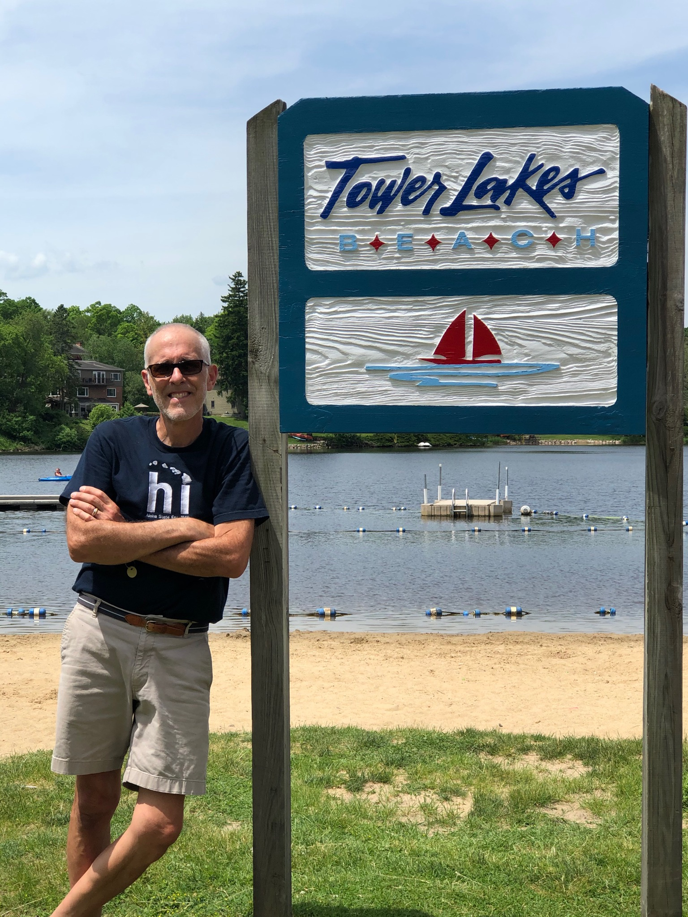
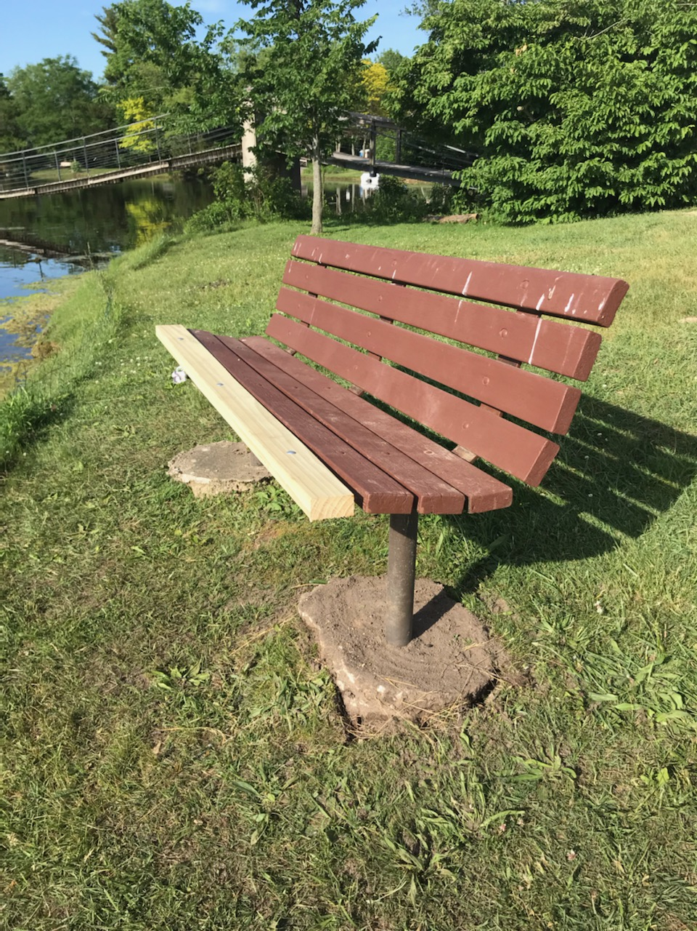
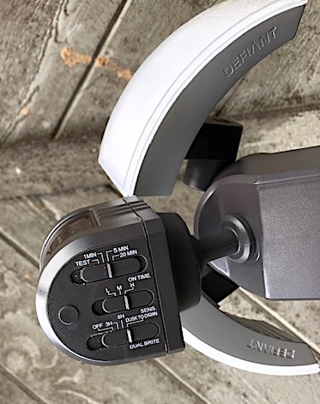
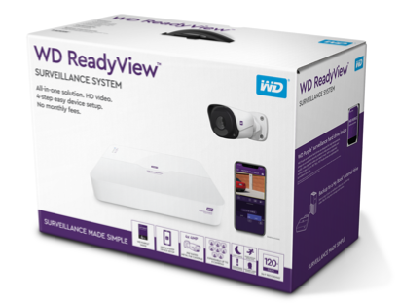
2020 Photos

Slide 32
2020 Projects and Improvements
Stain two large picnic tables
Stain four 4-top tables
Stain four sitting benches
Repaint beach welcome sign
(front, back, posts)
Repair two brown umbrellas
Install tool hangers in guard shack
Hang and organize all tools
Clean and install new refrigerator for guard shack
Hang guard profile white board on side
of guard shack
Hang the clock on the guard shack
Install a hook on the guard shack for the chalk board
Install new cup hooks for Open/Close sign
Discard all abandoned beach items remaining from 2019 season Replace one toddler swing

Slide 33
2020 Projects and Improvements
continued
WD-40 to all swings to stop the squeaking
Leveled the beach sand top to bottom
Fixed door lock closing problem on the guard shack
Replaced the ventilation cover on the exterior of the guard shack
Pulled up and leveled the bench next to the lifeguard boat
Installed the missing front rail for the bench next to the lifeguard boat
Applied mulch to cover the concrete pads of the bench next to the lifeguard boat
Repaired guard shack door frame and installed reinforced latch
Security system with three cameras installed on guard shack*
Three security lights installed on guard shack*
Guard shack totally emptied, deep cleaned, and reorganized for beach closing
* Beach Committee shout-out to Mark Handley for organizing these installations

Slide 34
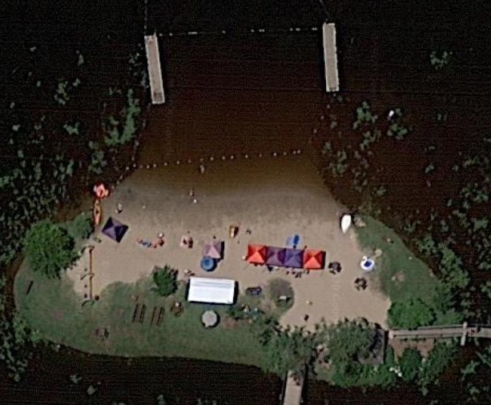
2021 Preview
Guard Shack roof to be pressure washed and shack painted
Additional umbrellas to be purchased for all picnic tables
New swim area ropes and buoys
We’re always looking for new Beach Committee members. Send an email to beach@TLIA.org or reach out to Mary Magro or Andy Milne. If you see maintenance or repairs needed at the beach, contact Don Sidlowski.

Slide 35
Grounds Committee
Mike Megleo

Slide 36
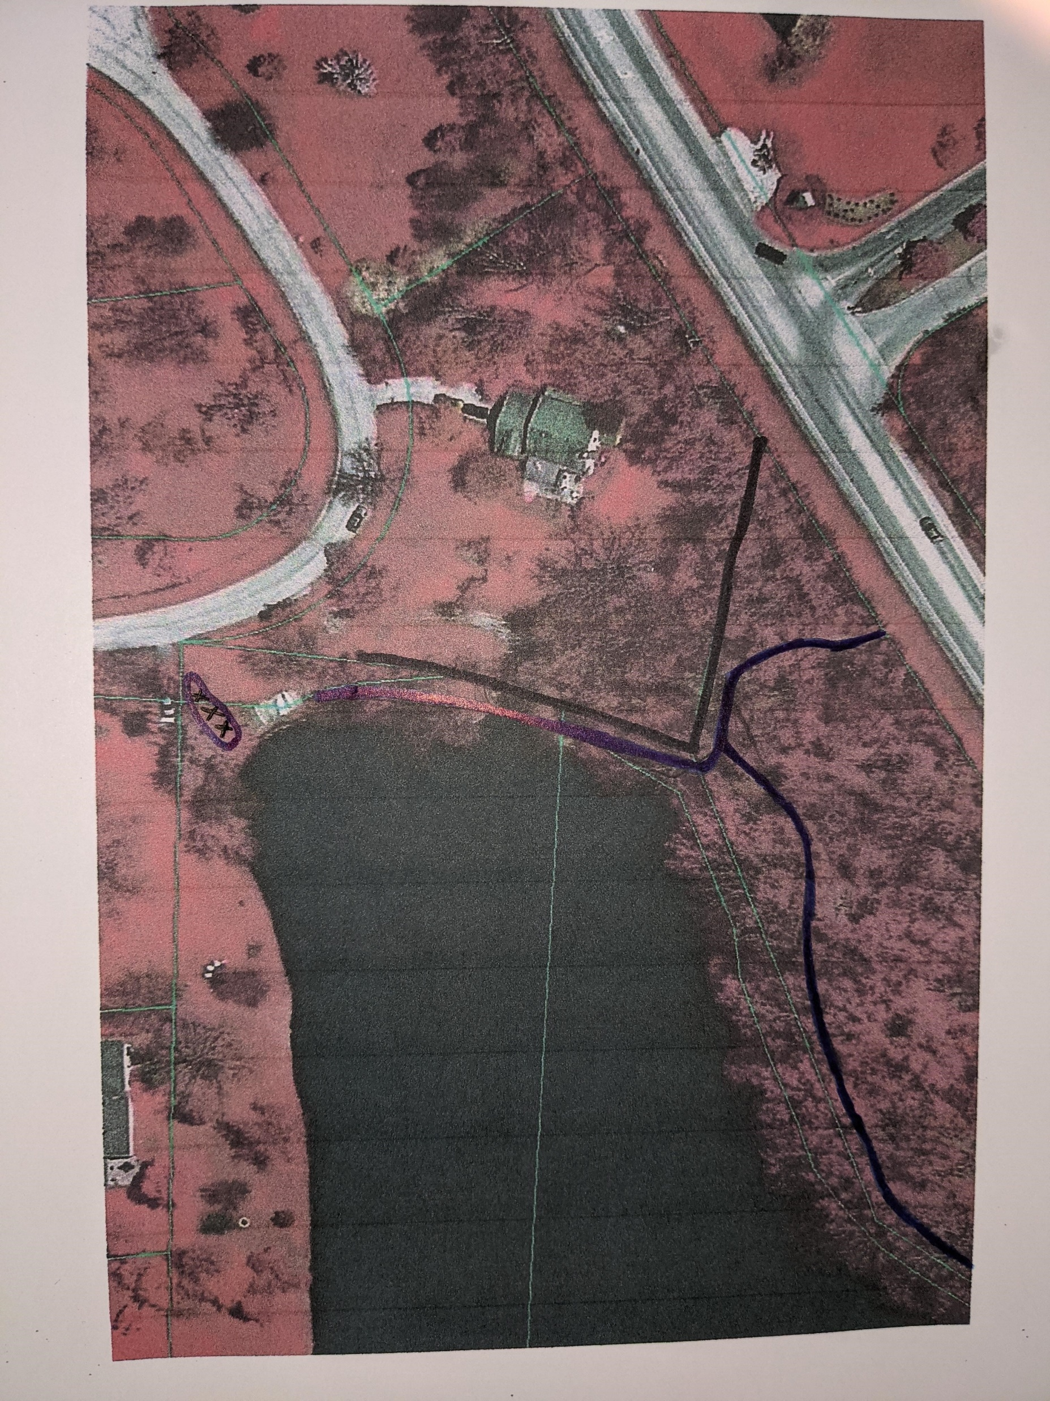
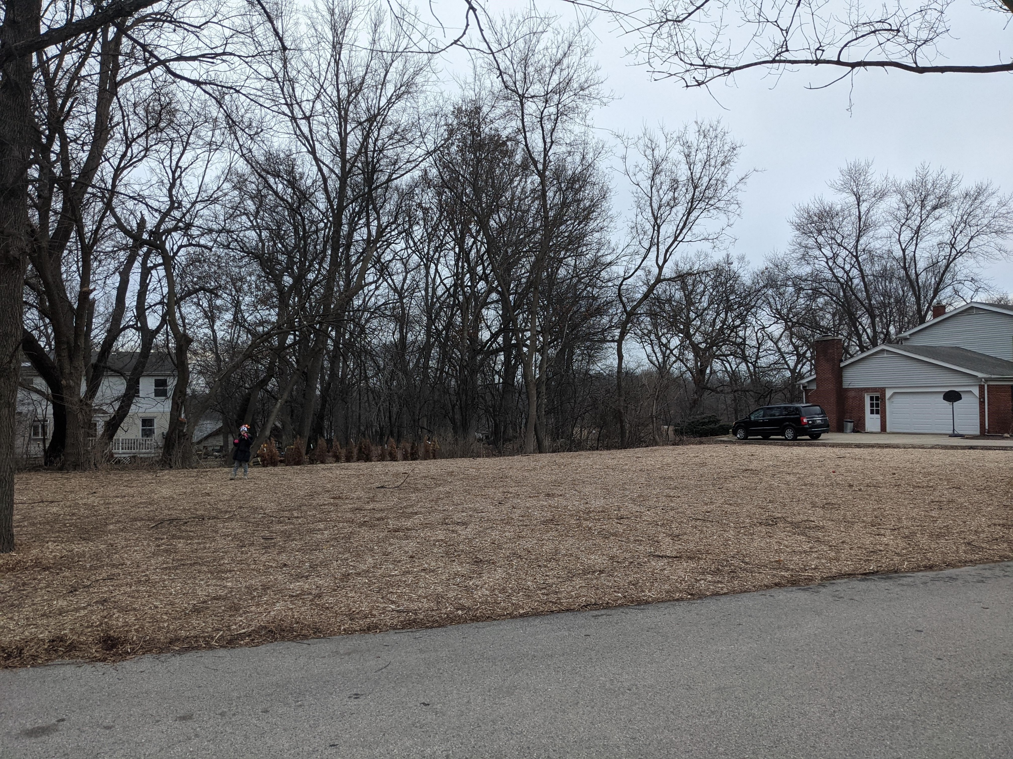
Grounds Committee 2020
Walk TL Path through Kelsey Lot B
Zupancic Park - Leveled and Mulched. Ready for equipment.

Slide 37
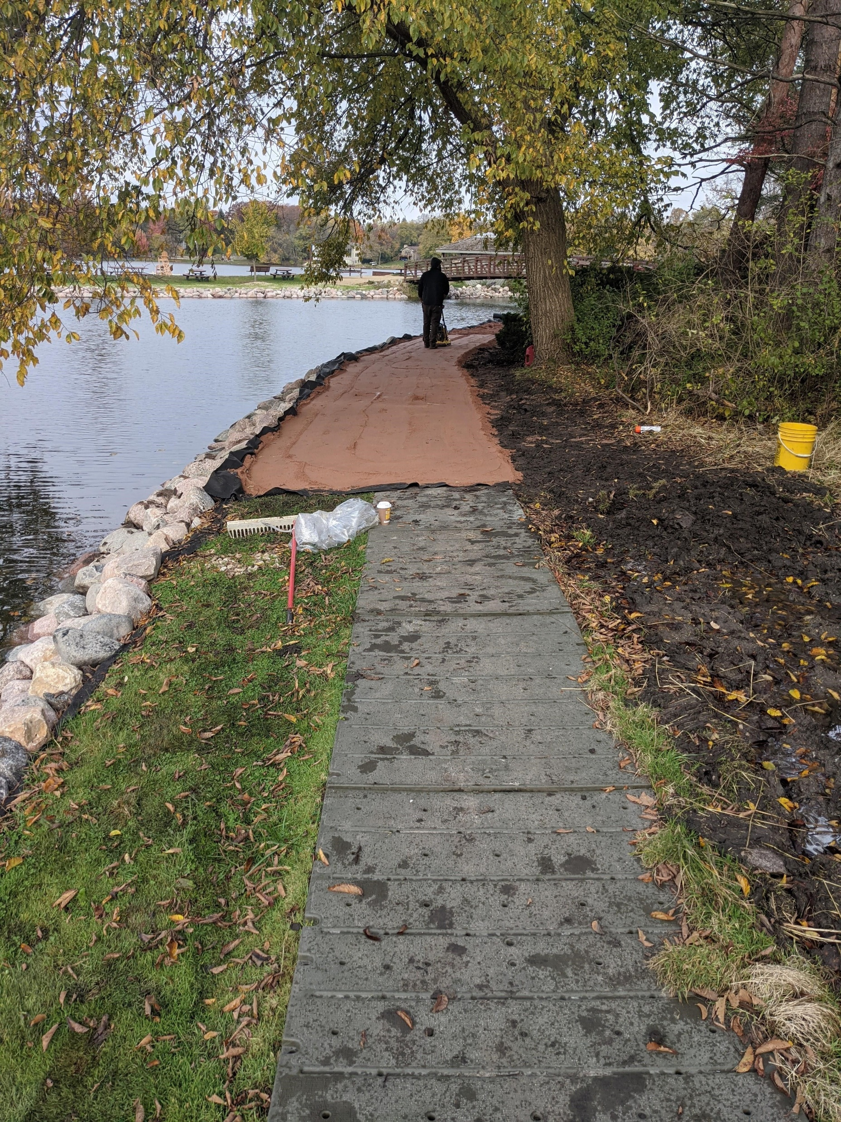
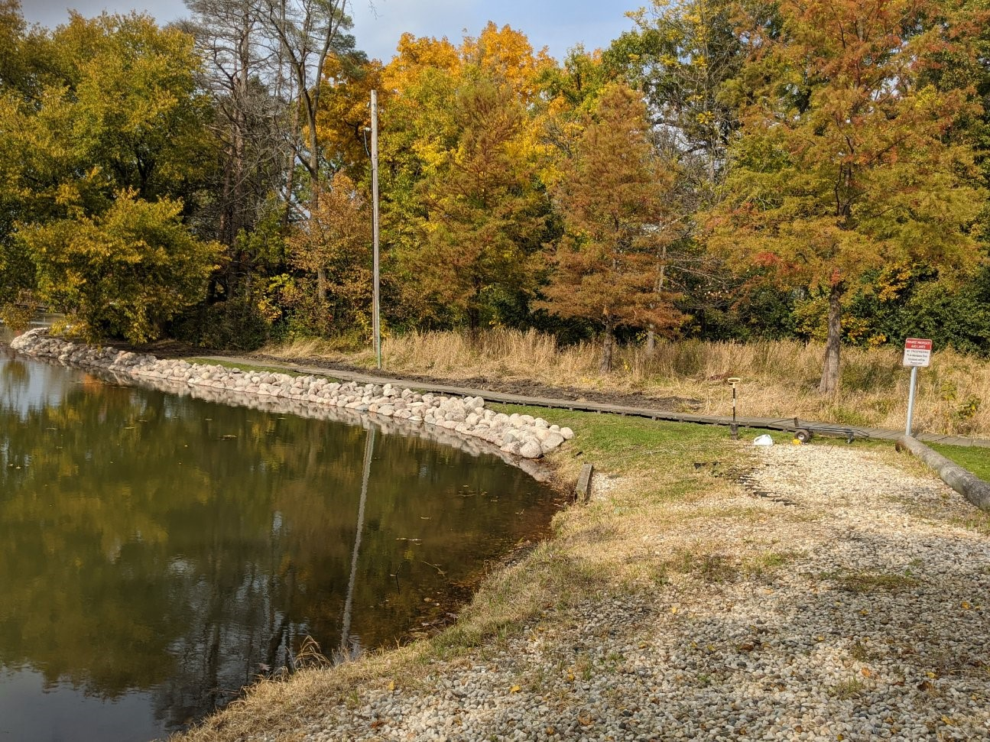
Grounds Committee 2020
New water fountain and landscape water spigot
Crushed Granite and raised plastic walkway from Wagner Park to beach

Slide 38
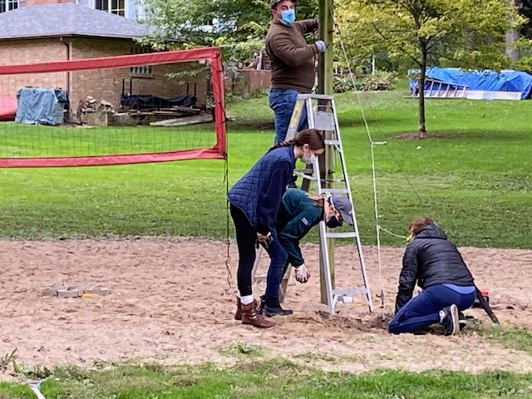
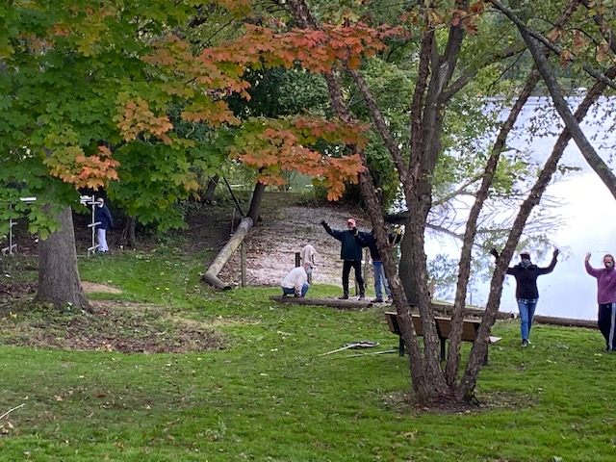
Grounds Committee
2020 Clean Up Day
Amazing turnout this year
Prepped Volleyball Court
Cleaned Wagner Park
Fixed swings at Iversen Park
Cleaned up logs at several locations
North Lake boat landing Cleanup

Slide 39
Stewards of the Parks
Steward | Park
 | Aram Park
Nick Adams | Barsumian Park
Mary Beth Adams | Barsumian Park
Mary Lenling | Bays Park
Anne Hay | Bays Park
Jerry Metzl | Beach
 | Boat Landings
Kevin Middleditch | Gordon Lewis Park
Stuart Todd-Middleditch | Gordon Lewis Park
Jack Breen | Iversen Park
John Yancey | Murray Park
 | North Lake Boat Landing
Steward | Park
 | Rose Park
 | Rose Park
Mike Mitchell | Soccer Field
Patricia Covek | Toy and Rest Island
 | Toy and Rest Island
Jen Grey | Wagner Park Avenue K

Slide 40
Long Range Planning Committee
Michael Megleo
Steve Kruse
Colin Regan

Slide 41
Accomplishments
Shoreline Restoration
    Areas completed: beach, walkway from beach bridge to Wagner Park
    Gateway and Edward Lane Boat Landing
Walk TL Trail
    Reestablishing Path through Kelsey Lot B
Zupancic Park
    Cleared, Weeded, Leveled and Mulched
Beach Piers Replaced

Slide 42
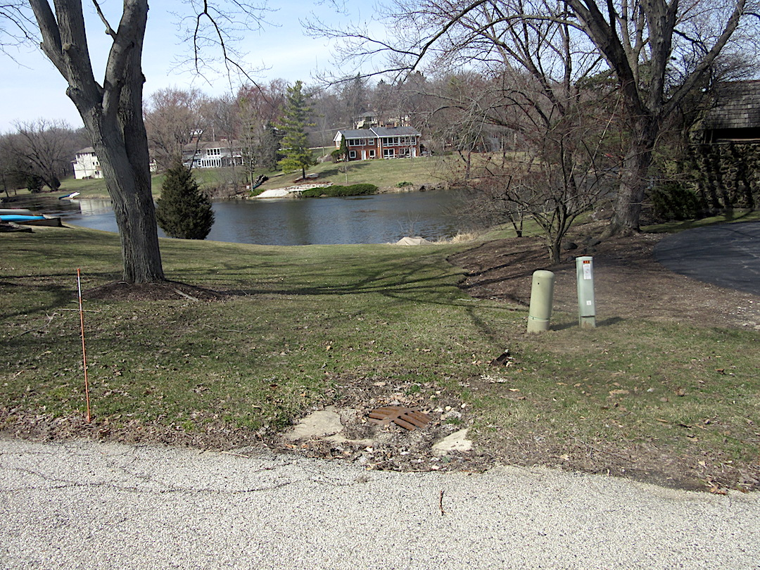
Long-Range Plan
Action Items for 2021
Boat landing —
130/134 South Hills Dr
Zupancic Park Play Equipment
Lindy Lewis gazebo railing fix
Improve volleyball court
Hussissian Park Drainage
Several Boat Racks
Continued Shoreline Restoration

Slide 43
Long-Range Plan
Document is subject to revision, enhancement
As needs or budgets change,
plan changes
Grounds committee can take this forward as a guide to future actions

Slide 44
Grounds Beautification
Committee
Patricia Covek

Slide 45
Projects & Kudos
This has been a very trying but very productive year. We are very pleased with all the compliments we received for our efforts. We started as usual:
Early spring ordering our supplies and cultivars for delivery in May.
Supervised Spring Clean-up and maintenance and mulching of all landscaped properties.
Planting material was delivered in May and we were very thankful for all the help we received unloading the truck-it was a big job.
Lee Johnson and her crew planted and maintained all the barrels and bridge planters until late fall.
The Boes planted and cared for the perennial garden near Rest Island for several years and this year was no exception, they did a beautiful job.

Slide 46
Projects & Kudos
Susan Dehnert and Pat Covek maintained the Memorial Garden as well as the Butterfly Garden near the bridges and had a beautiful display of Tulips this spring and have planted several hundred for Spring 2021.
Kathy Covek has taken care of the soccer field and the Ruhlan Memorial Garden for the past 25 years. She plants and maintains the garden as well as fertilizing the field—a labor of love! Thanks Kathy
Mary Magro and Paula Voska have been servicing North Lake for the past 20 and have done an outstanding job; They have plans for an upgrade for the 2021 season. Mary also takes care of the area her late mother Carol took care of for years; The East Lake Shore entrance and the plantings on the Crossway.

Slide 47
Projects & Kudos
Mary Beth Adams and the late Gordon Iversen have spent an unbelievable amount of time working in Barsumian Park We cannot Thank them enough for all their efforts. They have wonderful future plans, and we will continue Gordon’s vision for the park's future—We are so blessed that Gordon graced our community. He was one of the back-bones of our Beautification Committee and contributed so much over the years.
Diane Thompson took care of the South Hills entrance and we received help from many others like Carol Rolfs, Ann Hay, Birgit Riepe, Julie Kanak, Jean Mall, Ellen Sandcamp, Dan & Debbie Devitt, and The Spicers as well as a few others I may have missed…
Thank You all!
Fran Steffens plants and maintains the Rose garden on Rest Island, beautiful job!
All other projects and plantings have been serviced by Carriage Landscaping, who have done an excellent job for us for the last 25 years

Slide 48
Projects & Kudos
We have many talented people on our committee. Our educational portion consists of several Master Gardeners some Chemists and landscaping design and art professionals.
This fall we addressed the COVID-19 problem and decided to do a project for the Youth of our community. We created a Pumpkin patch garden with the help of Hugh Davis III, so our children could have Halloween memories. It was such a success, we decided to recreate the project for Christmas. Thanks to Hugh’s hard work and creativity it was outstanding. The Coveks and Dehnerts decorated the Gates and East Shore Drive. The Magro Family did North Lake and helped with the Main Tree. Thanks everyone!

Slide 49
Projects & Kudos
One of our big projects in coordination with the Grounds Committee and
Mike Megleo for 2021 is the refurbishing and design of Rest Island.
Carriage Landscaping has already completed remodeling the Reading Circle and thanks to Mark Handley, some of the benches have been restored. Thank you Mark you do beautiful work! We plan to finish this project in the Spring and will bring our plans to the board for their approval.

Slide 50
Communications Committee

Slide 51
Communications Committee Members
Mary Kay Bolger – Outgoing Chairperson
Jan Bahr – TLIA Newsletter Editor
Caroline Milne – Eblasts
Rob Dunbar – TLIA.org Webmaster
Kathy Pattengale – Advertisement
Mary Beth Adams – Welcome Committee
New Members:
Chris Miles
Marty Thompson
Janice Dunbar

Slide 52
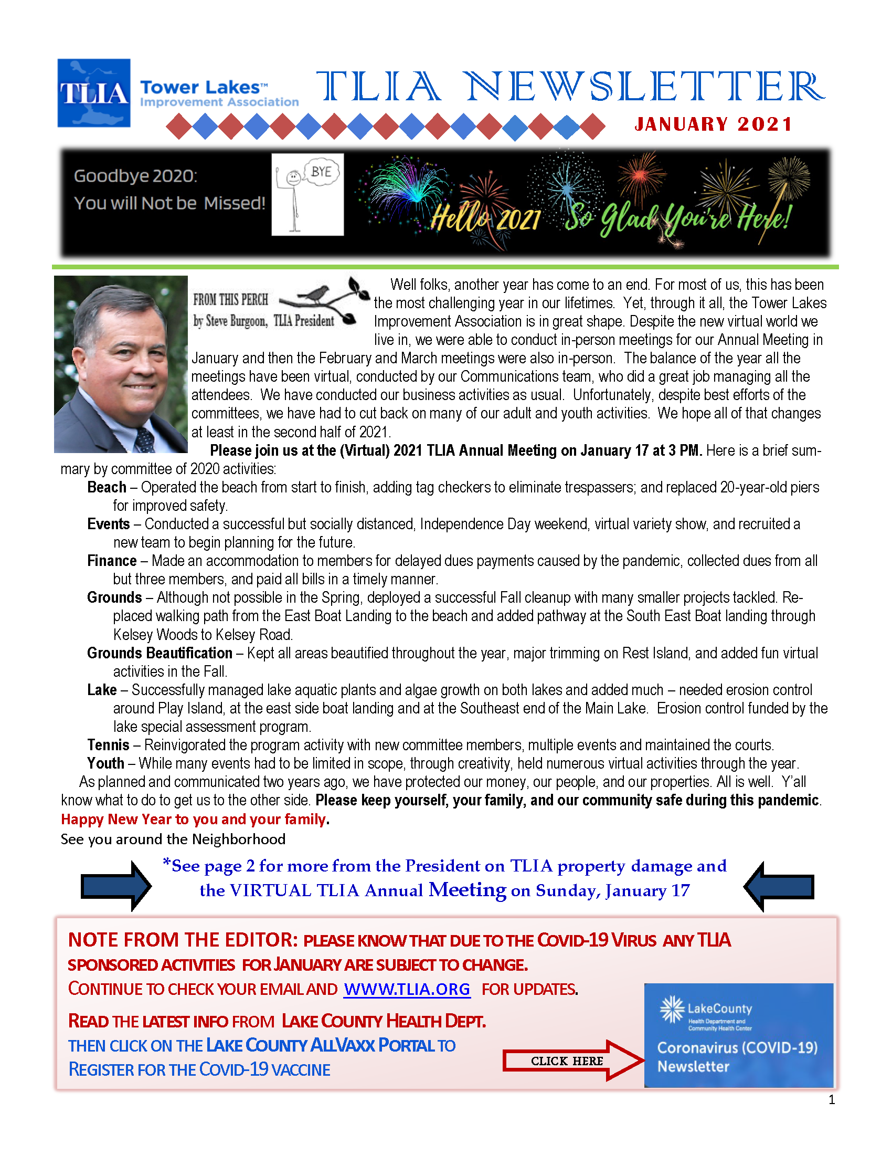
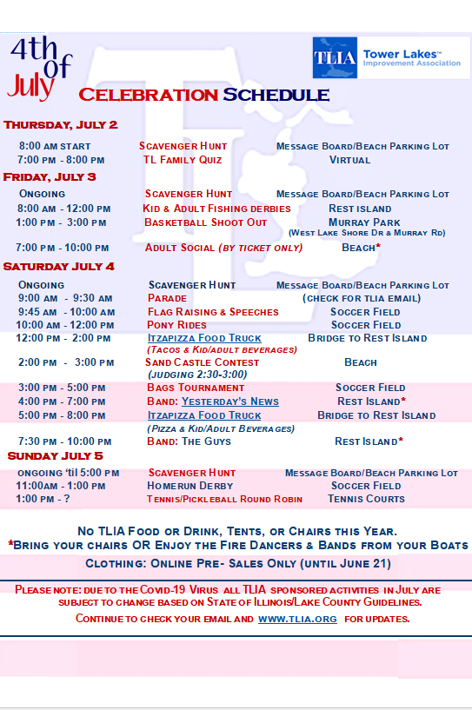
Newsletters, Eblasts & Posters
Jan Bahr & Mary Magro
Caroline Milne & Jan Bahr

Slide 53


New Resident Welcome & Advertisement
To Tower Lakes
Mary Beth Adams
Kathy Pattengale

Slide 54
2020 Website Accomplishments
Privatization (Password Protected)
Public vs Member Documents
Calendar of Events
Calling all Photographers – Photo Submission Request
Photo Gallery
Home Page Carousel for Announcements

Slide 55
2020
Website Stats
Logins
Feb | 263
Mar | 319
Apr | 345
May | 319
Jun | 652
Jul | 460
Aug | 452
Sep | 407
Oct | 310
Nov | 373
Dec | 434
Total Logins | 4334
Download
Feb | 129
Mar | 176
Apr | 184
May | 197
Jun | 278
Jul | 186
Aug | 191
Sep | 191
Oct | 146
Nov | 143
Dec | 259
Total Downloads | 2080
Top Pages
Current Newsletter 1,311
Home Page 1,078
Beach 126
Communications 111
Member Services 107
Photo Gallery 86
Events 83
From This Perch 73
Lake 70

Slide 56
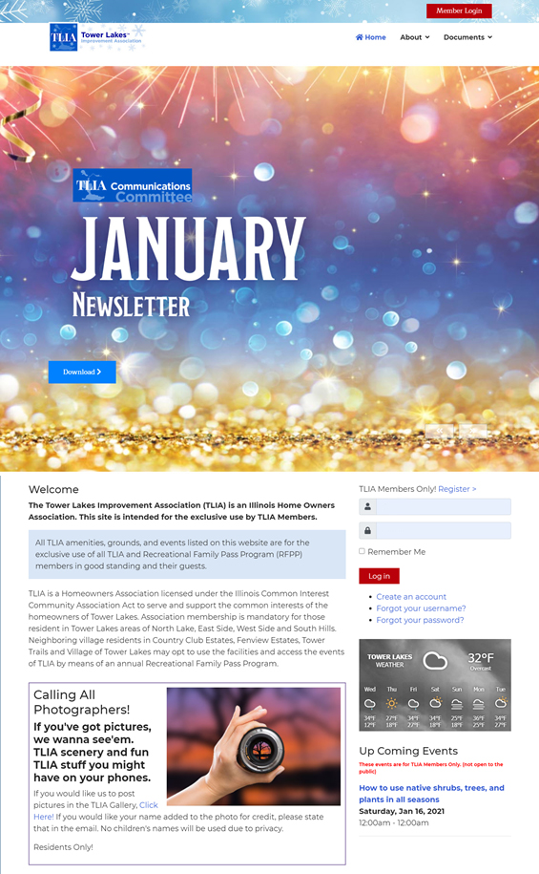
TLIA.org Website
New for 2021
Update format
Enhance usability for mobile phones
Improve Calendar/Events listing
Streamline Member Registration
Integrate Newsletter into the site
(no more PDFs)
Up to the minute weather panel
Seasonal Themes

Slide 57
Events
Committee

Slide 58
Current Events
Committee Members
Jeff Kernohan & Cathy Eckel
Bruce & Roxy Williams
Scott Sprague & Rachel Arden
Evan & Abby Condron
Spencer Shully & Magen Lapointe
We are fully staffed on the committee but would love volunteers to participate and show off their talents in the Virtual Variety Shows.

Slide 59
Events Committee Members who rolled off in 2020
Bobby & Melissa Covek
Tuno Ruiz & Anna Labbate

Slide 60
2021 Proposed Events
Virtual Variety Shows - Monthly
Progressive Dinner – Fall
4th of July
Fall Events: Music in the Park,
Kayak Concerts, Murder Mystery Dinner
Chili Cookoff – October
Additional Events: TBD

Slide 61
Tent, Table & Chair Rental Program Available for TLIA Members
Available Equipment & Daily Pricing Schedule
20 x 30 yellow/white tent, poles and stakes - $100
Plastic Tables (16) - $4 each
Plastic Chairs (42) - .50¢ each
(Note: need to provide your own vehicle to pick up and return any rented items)
Contact Events@tlia.org if interested

Slide 62
Thank You!
The 2020 Events Committee members:
The Guys, Pat McKillen, Casey Merkle,
Barb Wacholz, Annika Reipe, Don Sidlowski,
Maria Morales
4th of July: Volunteer Leads who took on a task to manage/run
All Volunteers: Thank you to everyone who volunteered for any of the events. We could not run these events without your time and effort to make Tower Lakes a great community.

Slide 63
Lake Committee

Slide 64
At-A-Glance
Long Range Plan
Hydrologic Study
Lake Treatment and current updates (Operating Plan)
Current EAM Contract Addresses many issues
Budget Overview
How we will move forward
Shoreline Erosion

Slide 65
Lake Committee
Lake Treatment Progress
    Contracted with Environmental Aquatic Management for 2021
    $45000/year comprehensive treatment
        Algae, Lilly Pads, Aquatic Vegetation
Fishery Management and Stocking efforts for 2021 and beyond
Ongoing Education around Fishing Regulations
Water Safety-Partnership with Youth and Beach
Animal Control-Geese and Beavers
Water Mover
  Mitch Coulter
  Tom Kubala
  Colin Regan
  Rich Bahr
  Steve Kruse
  Rocky Ermilio
  Pat McKillen
  Eric Torstenson
  Willy Knight
  Whitney Bruni
  Nick Adams
  Judd Lautenschlager
  Fran Douros
  Jen Grey
  Walt Dethlefesen
  Quinn Rowley

Slide 66
Long Range Plan
Erosion Control and Prevention
    Challenges of higher water levels and increased rainfall YOY
    Many parts of the lake are being affected
    Dam management practices implemented
    Partnership with Grounds and Long Range Planning to install boulder retaining wall in two locations:
            Wagner Park to Play Island Bridge
            Around Play Island from Beach to Beach
            ~650 Linear Feet
            140 metric tons
    SE Boat Landing area cleared and additional boulder retaining wall to support WALK TL Plan
  Phoslock Treatment for North Lake
  H&H Study
2020 Activities

Slide 67
Hydrologic & Hydraulic (H&H) Study
Phase 1 Study Completed
    Gauges Installed – 3 in ground, 3 in the lake system
    Model Developed and Completed – Water levels, impact from Rainfall
    Focused in the Soccer Field area
    Initiate Database for project prioritization, potential grant applications
Phase 1 Recommendations – Improve Stormwater Management in and around Soccer Field
    Smaller Project
        Fill added
        Bioswales/Improved drainage
    Larger Project
        Build on Smaller Project, Infrastructure Improvements
Next Steps
Agreement with Village on Approach
2021 – Ongoing data collection for future planning
Collaborative Effort with the Village of Tower Lakes
Partially Funded via WMB grant from Lake County Stormwater Management

Slide 68
Budget Overview-Special Lake Assessment
Lake Assessment Funding
    2019 Activity
        Silt Removal
        Weed Harvesting
    2020 Spend
        North Lake Phoslock Treatment
        Shoreline Erosion
        H&H Study
    2021 Plan
        Soccer Field/Stormwater Improvement
        $114,000 remaining to be spent
    What’s Next?
        Ongoing Shoreline Improvement Plans
        Dam Considerations
        Silt Removal/Lake Depth
Goal: Research and experiment with other lake management Nest Management Practices

Slide 69
Member
Services

Slide 70

2020 Accomplishments
Printed and delivered Tower Lakes Phone Directory at no cost to TLIA thanks to our advertisers
Special thanks to Tower Lakes residents who helped with deliveries:
    Laura Dominiak
    Kevin Middleditch
    Nathan Janitz
    Mary Beth Adams
    MK Bolger
    Kevin Powers

Slide 71
2020 Accomplishments
Distributed 730 swim tags; 250 boat decals
Successful boat landing cleanup in fall; special thanks to Tower Lakes youth for their assistance: Luke Losinski, Matt Breen, Brian Breen, Huey Davis…and Don Sidlowski (young at heart)
Sold two abandoned boats, recycled three
Set up online ordering of boat decals and swim tags for 2021
    https://forms.gle/PLrnYyDGERGbSseT8
Plans for 2021: work with Grounds to order and set up four additional boat racks at landings to alleviate overcrowding

Slide 72
Tennis
Committee
Tennis Committee Co-Chairs
Jeanne Mitchell
Christine Messerschmitt

Slide 73
Tennis Report
The tennis committee met via Zoom in the spring of 2020 and followed the CDC and governor’s recommendations for opening the courts for safe play during the Pandemic.
Signs were posted with rules for social distancing and safe play.
There was a successful summer of Adult and Youth lessons.
Adult pro was John Sisto from The Racket Club in Crystal Lake.
Adult lessons were on Friday and Saturday mornings.

Slide 74
Tennis Report
There was a men’s tournament and a round Robin social in September.
Social distancing was practiced for these events.
The courts were cleaned in the spring and summer and fall as needed.
Nets were taken down on Sunday November 28 by Bob and Kathy Covek. Weather permitted us to play through November.
The committee will plan a Zoom meeting in the Spring of 2021 to plan for the 2021 Season.
Tower Lakers Barbara Covek and Kelly Dehnert taught the youth lessons on Monday-Thursday mornings.

Slide 75
Youth
Committee

Slide 76
Youth Committee Members
2020
Meg Koszulinski
Beth Coulter
Audra Powers
Kimberly Saunders
Gina Thompson
Laura Janitz
Sam Ruda
2021
Gina Thompson
Laura Janitz
Sam Ruda
Sarah Meyer
Surbhi Panchal
Mallory Laumann
Trista Janzen

Slide 77
2020 Accomplishments
Giving Back Event: Feed My Starving Children
Virtual Easter Egg Hunt
Family Yoga
Water Safety Meeting at the beach
Family Movie Night
Playdate for New Kindergartners (one instead of two)

Slide 78
2020 Accomplishments
Pumpkin Carving Contest
Halloween Costume Parade
Turkey Trot (first time Youth was involved)
including T-shirt design contest
Holiday Decoration Scavenger Hunt
Gingerbread House Contest

Slide 79
2021 TLYC Calendar
(Tentative based on COVID protocols)
  April
Easter Egg Hunt April 4 at 10am
May
Tot Soccer May 8, 15, 22
(Soccer Field)
June
Family Campout June 5 at 6pm
(Barsumian Park)
Summer Kickoff/Beach Safety Event
date to be coordinated with Beach and
Lake Committees
Family Yoga June 4, 11, 18, 25 at 11:30am (Rest Island)
Kindergarten Playdate June 6 at 11am (Iverson Park)

Slide 80
2021 TLYC Calendar
(tentative based on COVID protocols)
  July
Holi Celebration July 31st 2pm
August
Back to School Bash August 14 at 3pm (Soccer Field)
Kindergarten playdate- August 15 at 11am (Aram Park)
September
Family Movie Night Sept 10 at 7pm (Barsumian Park)
October
Halloween Pre-Trick or Treating Pizza Party October 31 at 3pm (Soccer Field)
November
Turkey Trot November 25 at 9am
December
Holiday Festival Dec 5
Carriage Rides, Photos with Santa

Slide 81
2020 Ballot Results

Slide 82
Q & A and Final Comments

Slide 83
Adjourn

